Slide 1
13610 Banks Cres
OCP from Ag to HDR
Rezone from A1 to CD8

Slide 3
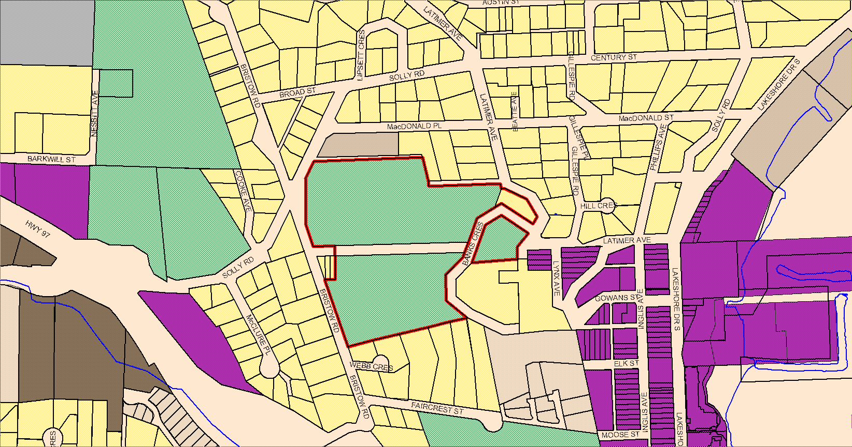
Official Community Plan
LDR
Ag
Park
TC
Ag
DC

Slide 4
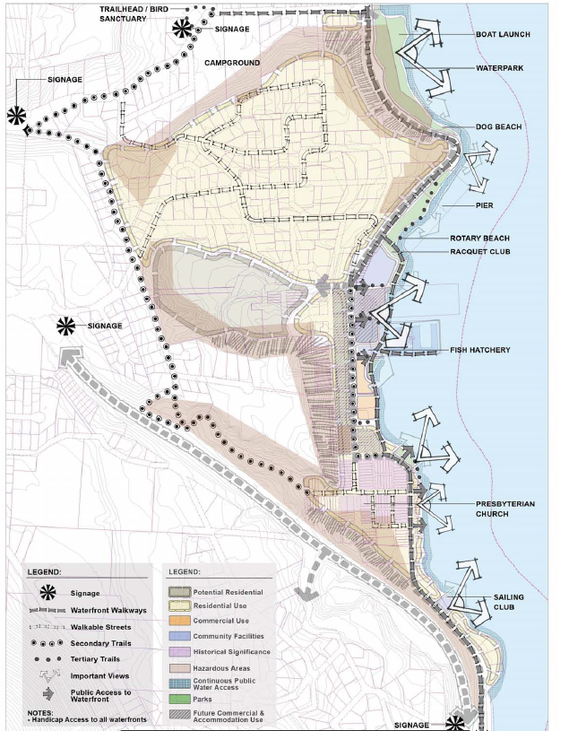
Lower Town Strategic Plan

Slide 5
Zoning
RSD3
A1
PR1
RSD1
CT1
A1
PP
DC

Slide 6
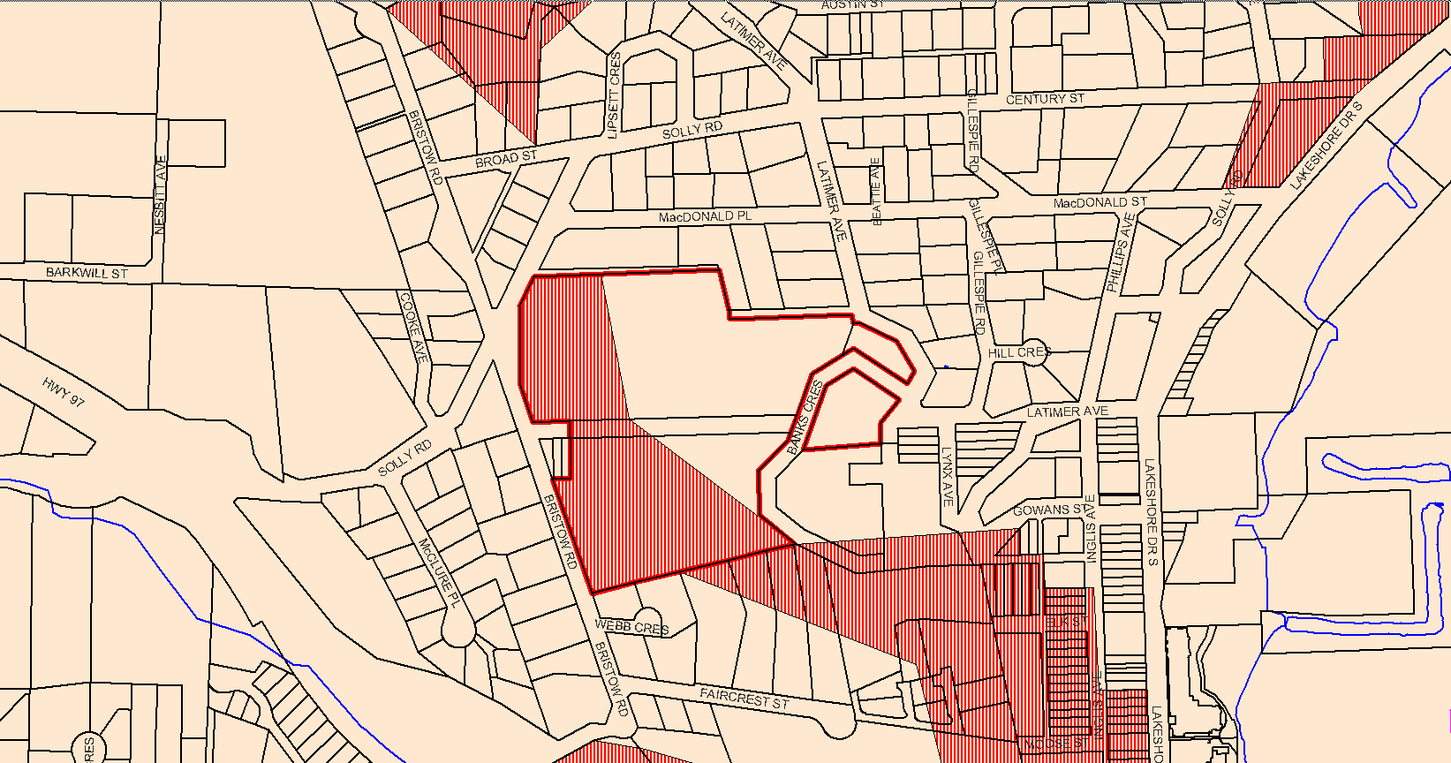
High Hazard DP Area

Slide 7
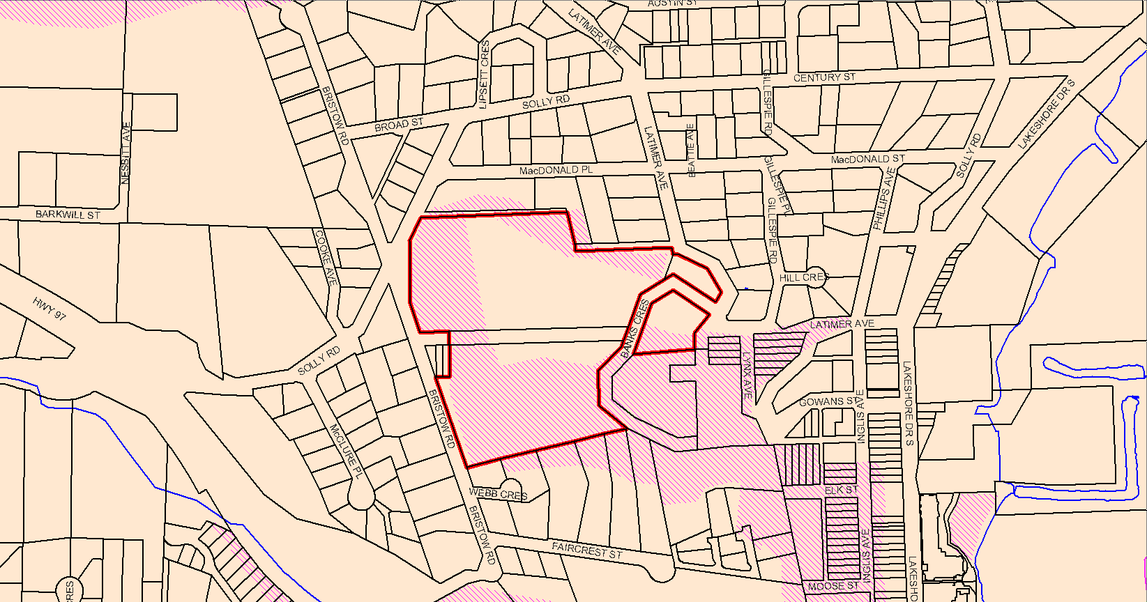
ESDP Area

Slide 11
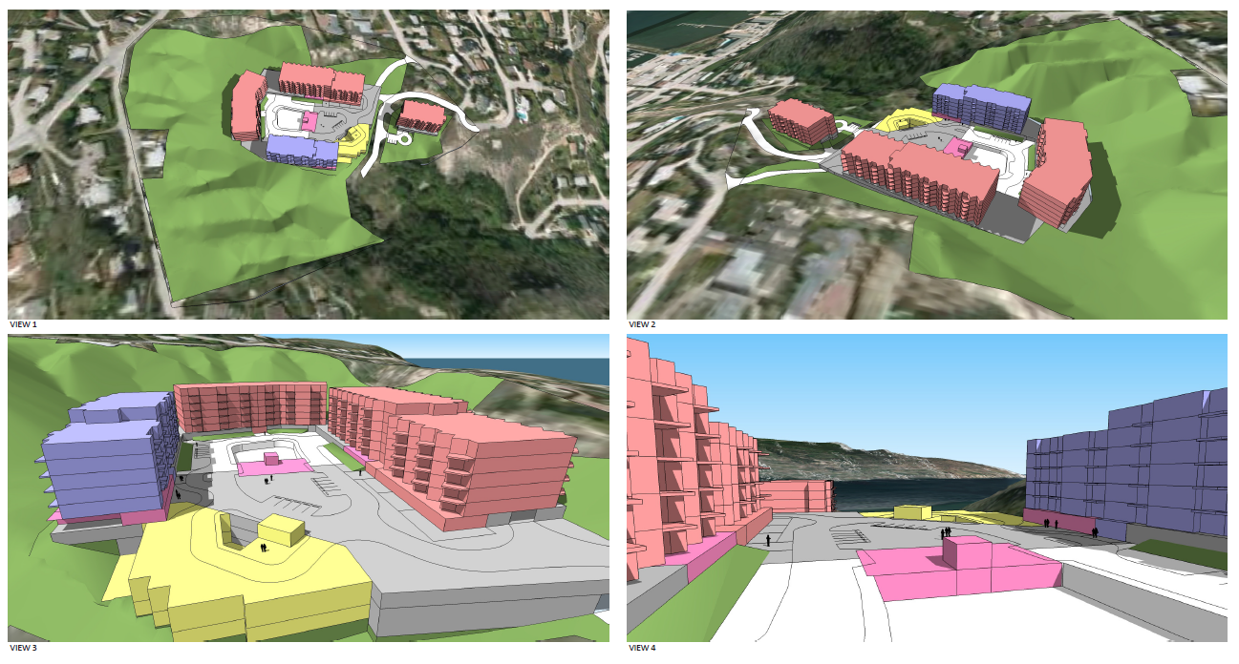

Slide 12
Community Amenities
Intersection upgrading
Road Upgrading
Pedestrian walkway
Sidewalk construction
Poles to be removed

Slide 13
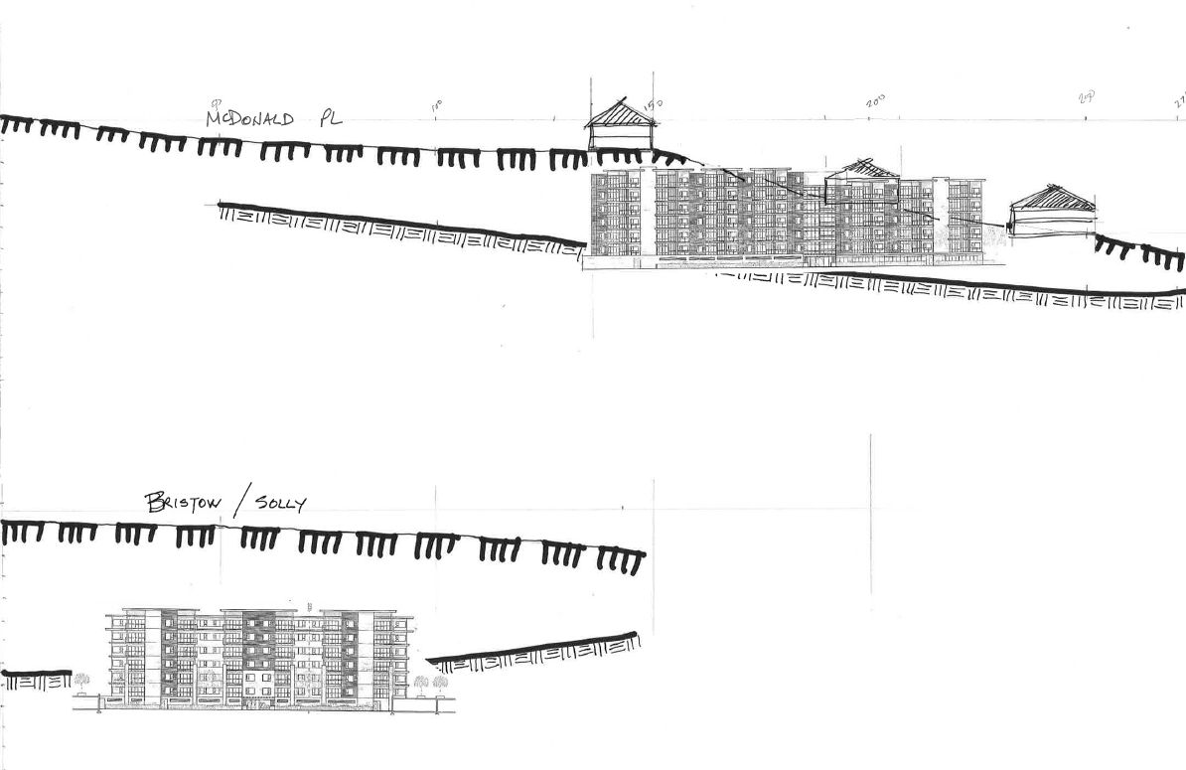
Looking North
Looking West

